Slide 1

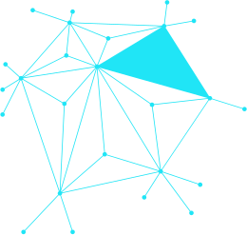
MINIMUM VERTEX COVER
Nikola Labus 094/2020

Slide 2


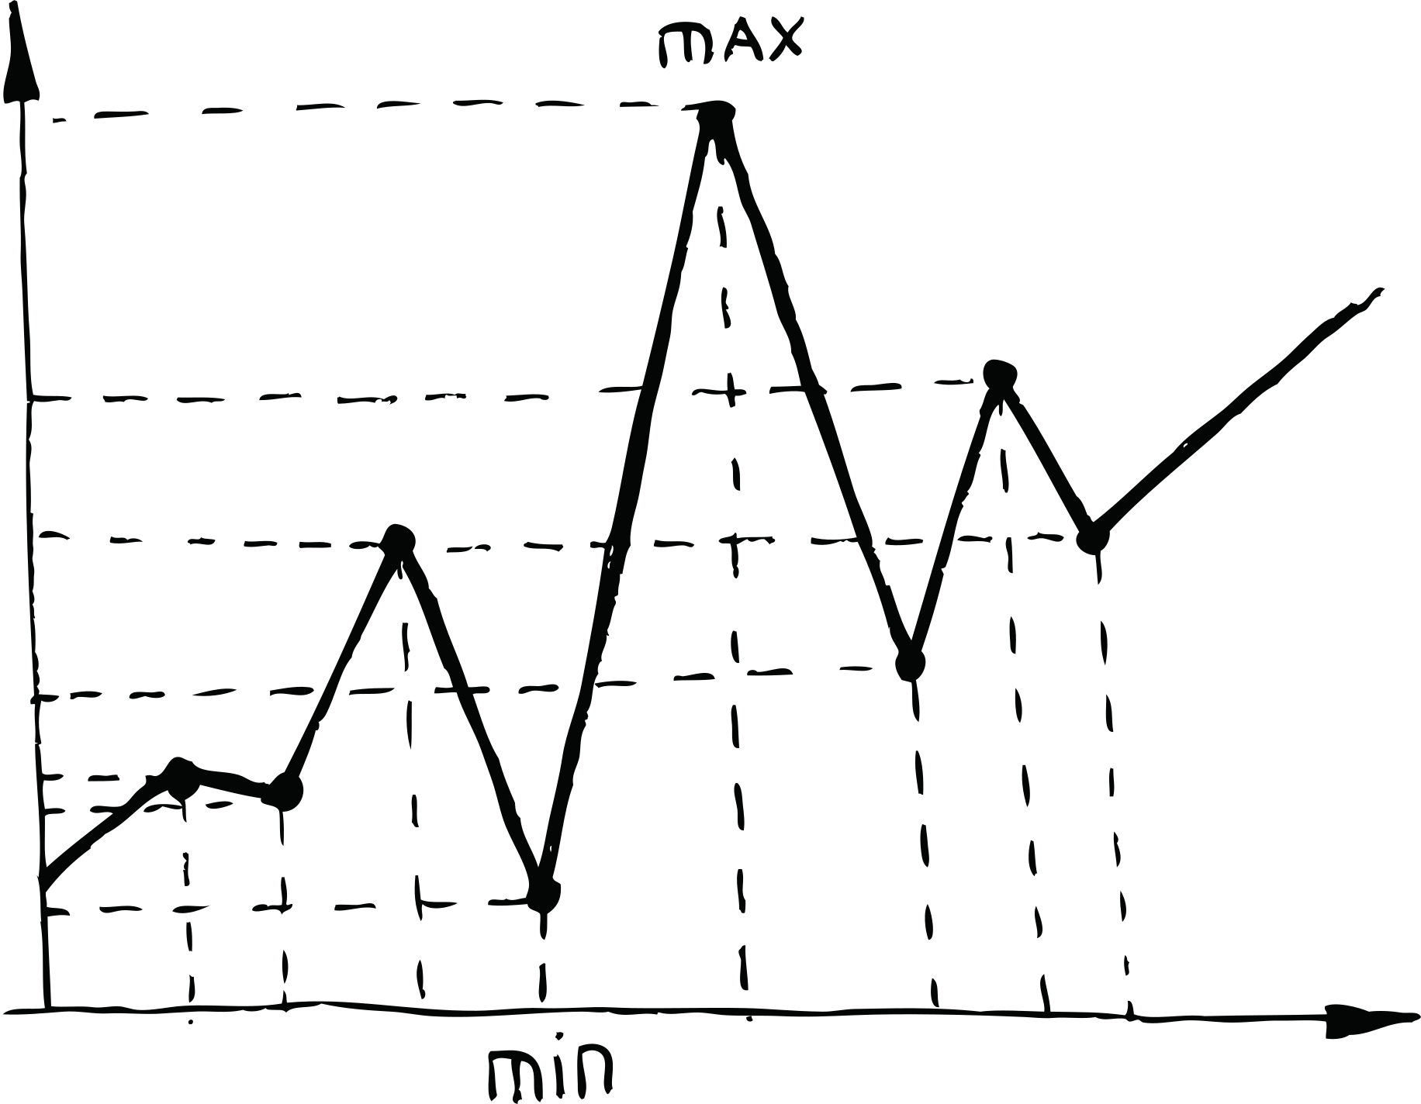

TEHNIKE:
Gruba Sila
S-Metaheuristike
Genetski Algoritam

Slide 3
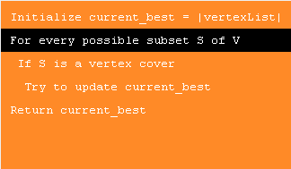
GRUBA SILA
Ispituje sva moguća rešenja, garantuje optimalno, ali je vremenski veoma zahtevna i neprimenljiva za velike probleme.

Slide 4
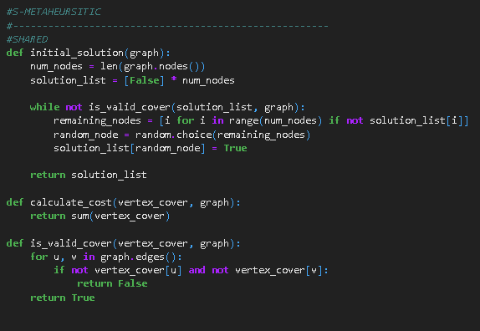
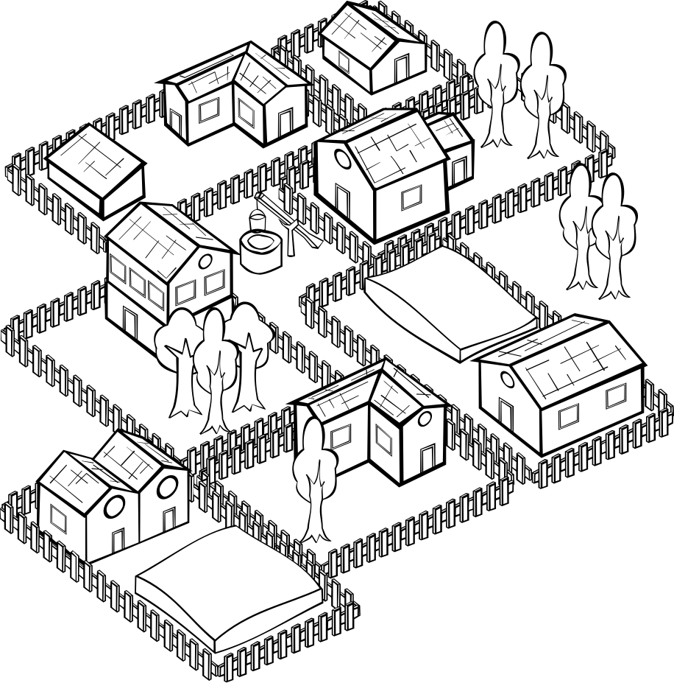
S-METAHEURISTIKE
Efikasno istražuju prostor rešenja, brzo pronalaze dobre rezultate i izbegavaju lokalne minimume, posebno kod kompleksnih problema.

Slide 5
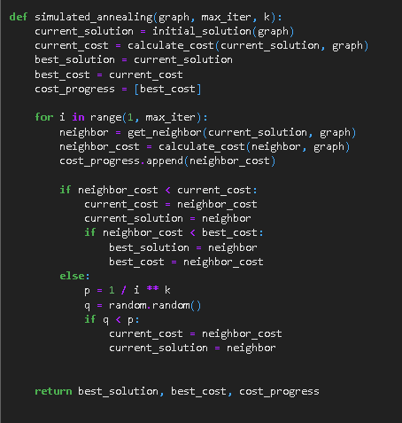

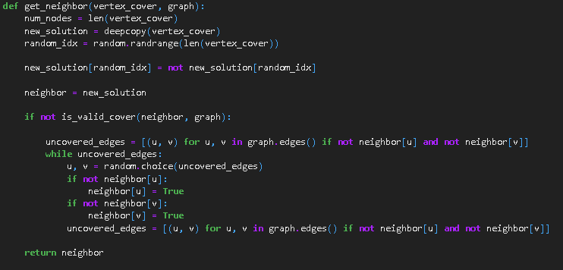

Slide 6
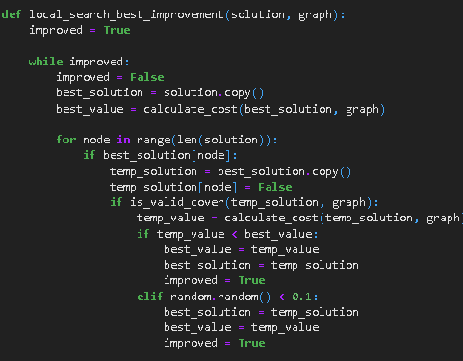
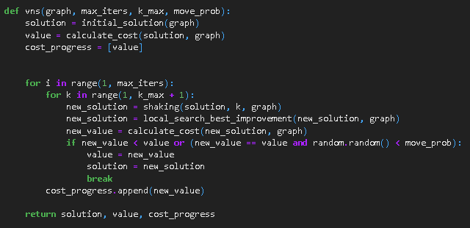
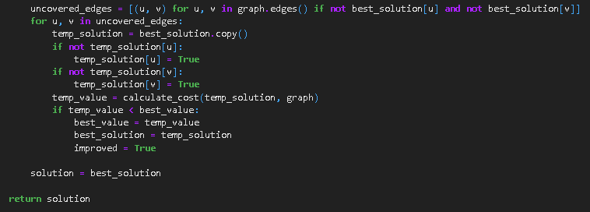
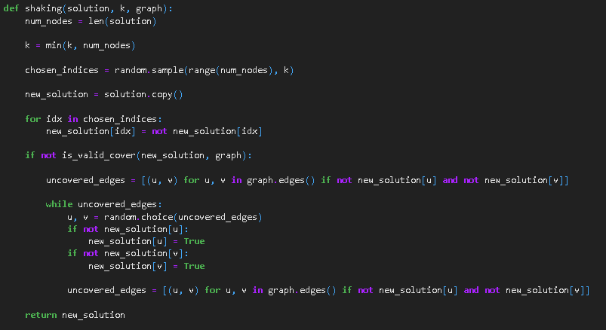

Slide 7


GENETSKI ALGORITAM
Koriste evolucijske tehnike, pružaju dobru eksploraciju rešenja, ali zahtevaju više resursa i vremena za optimizaciju.

Slide 8
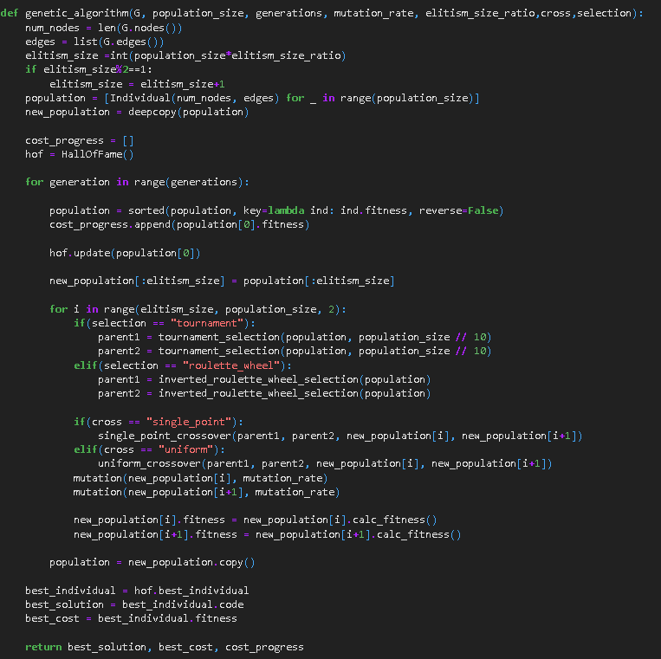
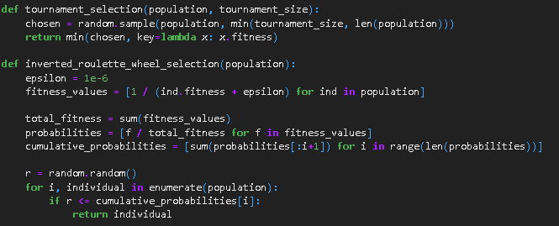
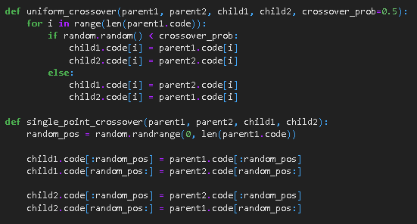

Slide 9
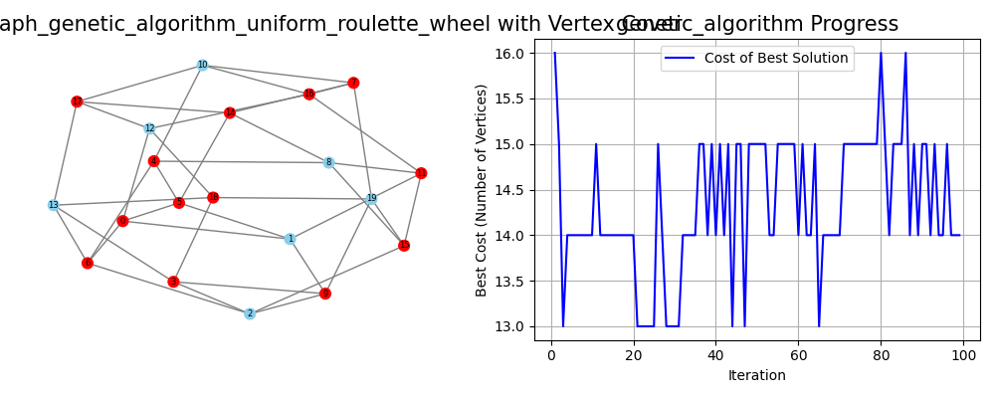
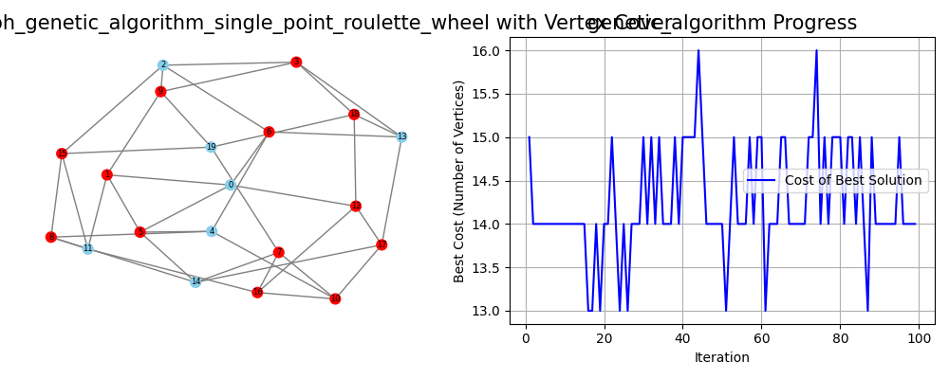
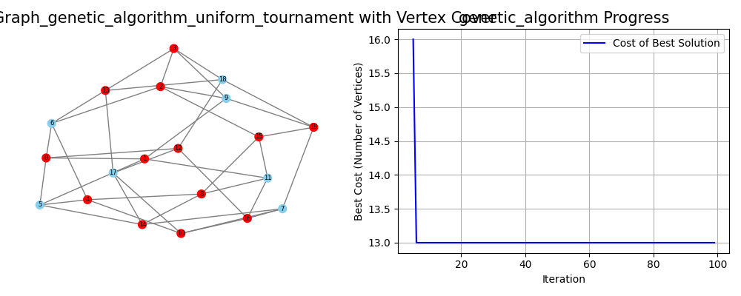
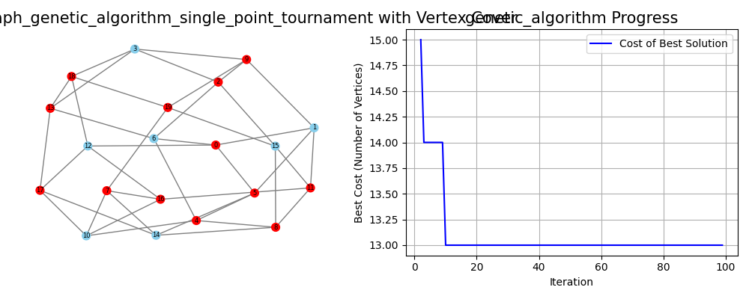
OPTIMALNOST GENETSKIH ALGORITAMA
GA SINGLE_POINT tournament : 13 in 0.52 seconds
GA UNIFORM tournament : 13 in 0.49 seconds
GA SINGLE_POINT roulette : 13 in 1.65 seconds
GA UNIFORM roulette : 13 in 1.74 seconds
BRUTE : 13 in 1.49 seconds

Slide 10
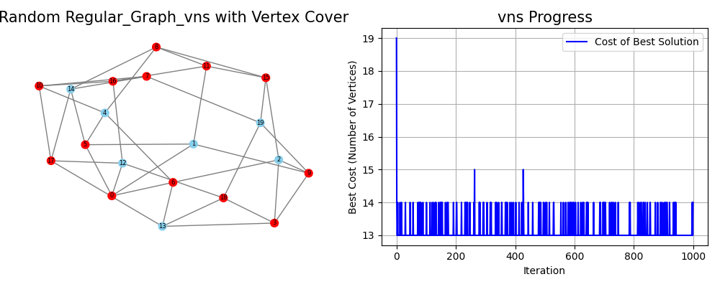
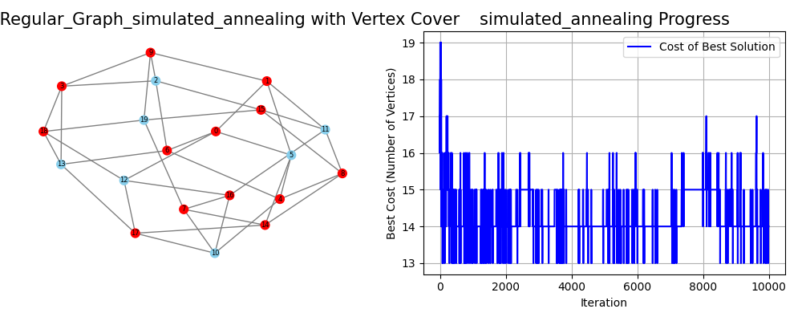
OPTIMALNOST S-METAHEURISTIKA
SIM : 13 in 0.32 seconds
VNS d: 13 in 0.54 seconds
BRUTE : 13 in 1.49 seconds

Slide 11
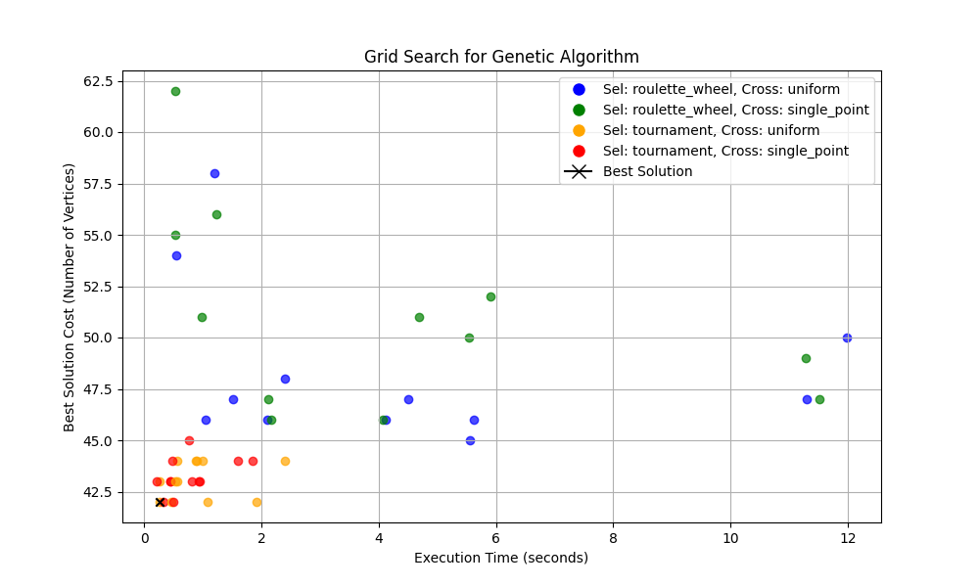
TESTIRANJE-NX.ERDOS_RENYI_GRAPH(50, 0.5)
SIM : 42 in 2.52 seconds
VNS : 42 in 8.12 seconds
GA: 42 0.2648 seconds

Slide 12
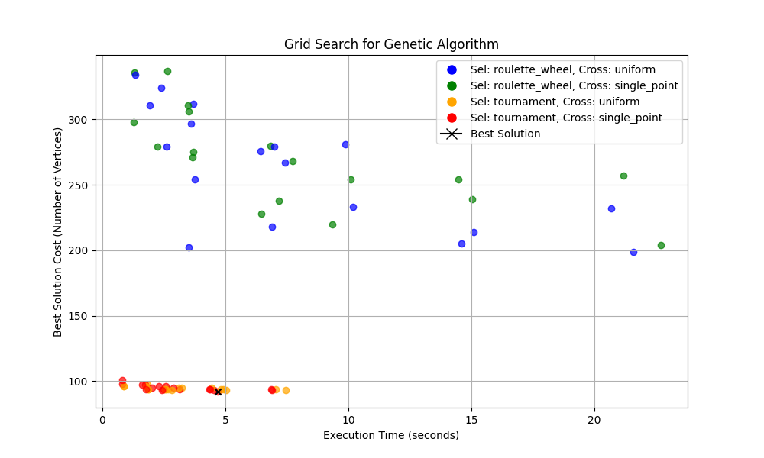
TESTIRANJE-NX.ERDOS_RENYI_GRAPH(100, 0.5)
SIM : 91 in 7.78 seconds
VNS : 92 in 27.93 seconds
GA: 92 4.695 seconds

Slide 13
Population Size | Generations | Mutation Rate | Elitism Size Ratio | Crossover Method | Selection Method | Vertices in Cover | Execution Time (seconds)
100 | 50 | 0.04 | 0.05 | Uniform | Roulette Wheel | 311 | 1.9412
100 | 50 | 0.04 | 0.05 | Uniform | Tournament | 96 | 0.8815
100 | 50 | 0.04 | 0.05 | Single Point | Roulette Wheel | 336 | 1.2962
100 | 50 | 0.04 | 0.05 | Single Point | Tournament | 98 | 0.8228
100 | 50 | 0.04 | 0.10 | Uniform | Roulette Wheel | 334 | 1.3317
100 | 50 | 0.04 | 0.10 | Uniform | Tournament | 96 | 0.8761
100 | 50 | 0.04 | 0.10 | Single Point | Roulette Wheel | 298 | 1.2822
100 | 50 | 0.04 | 0.10 | Single Point | Tournament | 101 | 0.8167
100 | 100 | 0.04 | 0.05 | Uniform | Roulette Wheel | 279 | 2.6251
100 | 100 | 0.04 | 0.05 | Uniform | Tournament | 97 | 1.8474
100 | 100 | 0.04 | 0.05 | Single Point | Roulette Wheel | 337 | 2.6316
100 | 100 | 0.04 | 0.05 | Single Point | Tournament | 97 | 1.7335
100 | 100 | 0.04 | 0.10 | Uniform | Roulette Wheel | 324 | 2.3919
100 | 100 | 0.04 | 0.10 | Uniform | Tournament | 96 | 1.7674
100 | 100 | 0.04 | 0.10 | Single Point | Roulette Wheel | 279 | 2.2249
100 | 100 | 0.04 | 0.10 | Single Point | Tournament | 97 | 1.6123
100 | 150 | 0.04 | 0.05 | Uniform | Roulette Wheel | 297 | 3.6012
100 | 150 | 0.04 | 0.05 | Uniform | Tournament | 94 | 2.6655
100 | 150 | 0.04 | 0.05 | Single Point | Roulette Wheel | 271 | 3.6629
100 | 150 | 0.04 | 0.05 | Single Point | Tournament | 96 | 2.5814
100 | 150 | 0.04 | 0.10 | Uniform | Roulette Wheel | 202 | 3.5227
100 | 150 | 0.04 | 0.10 | Uniform | Tournament | 94 | 2.5767
100 | 150 | 0.04 | 0.10 | Single Point | Roulette Wheel | 306 | 3.5250
100 | 150 | 0.04 | 0.10 | Single Point | Tournament | 96 | 2.3084
200 | 50 | 0.04 | 0.05 | Uniform | Roulette Wheel | 254 | 3.7695
200 | 50 | 0.04 | 0.05 | Uniform | Tournament | 94 | 1.8663
200 | 50 | 0.04 | 0.05 | Single Point | Roulette Wheel | 275 | 3.7094
200 | 50 | 0.04 | 0.05 | Single Point | Tournament | 95 | 2.0273
200 | 50 | 0.04 | 0.10 | Uniform | Roulette Wheel | 312 | 3.7030
200 | 50 | 0.04 | 0.10 | Uniform | Tournament | 94 | 1.8549
200 | 50 | 0.04 | 0.10 | Single Point | Roulette Wheel | 311 | 3.4863
TESTIRANJE-NX.ERDOS_RENYI_GRAPH(100, 0.5)

Slide 14
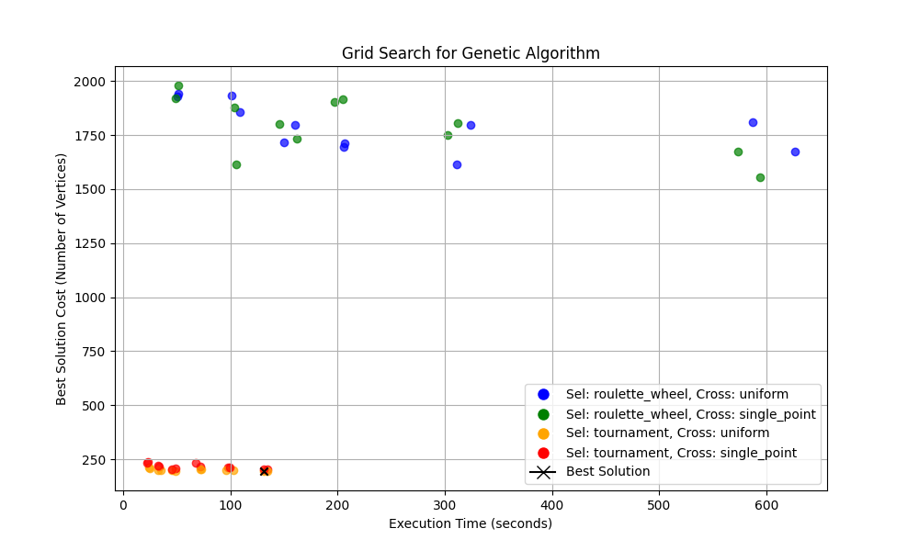
TESTIRANJE-NX.ERDOS_RENYI_GRAPH(200, 0.5)
SIM : 192 in 32.28 seconds
VNS : 191 in 81.53 seconds
GA: 195 131.49 seconds

Slide 15
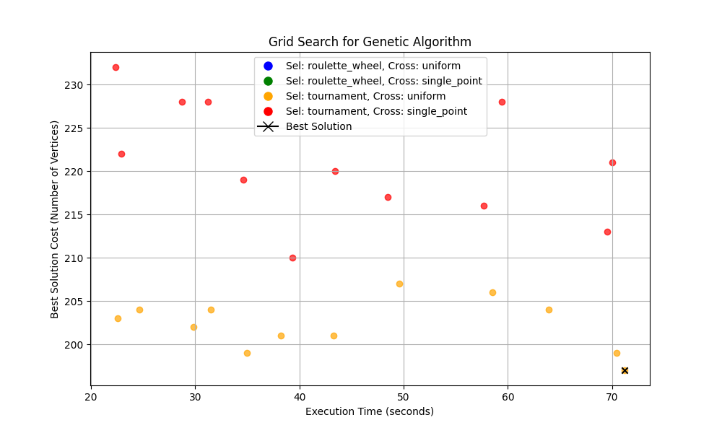
TESTIRANJE-NX.ERDOS_RENYI_GRAPH(200, 0.5)
SIM : 192 in 33.99 seconds
VNS : 191 in 99.86 seconds
GA: 197 71.17 seconds

Slide 16
HVALA NA PAZNJI

